Slide 1
Characteristics of a Good
Thesis and Presentation
Western International University
RES 603
Michael J. Miller, Ph.D
michaeljmillerphd.com
Copyright © 2000 - 2009 by Michael J. Miller. All rights reserved.

Slide 2
An Excellent Thesis…..
Does not contain grammatical and typographical errors
Aligns with prescribed formatting conventions
Is clearly written
Represents a rigorously conducted study
  Appropriate sampling
  Reliable and valid data collection instrument(s)
Contains actionable recommendations
Presents alternative viewpoints

Slide 3
Practicing Humility
Bertrand Russell (1950):
The essence lies not in what opinions are held, but in how they are held: instead of being held dogmatically, they are held tentatively, and with a consciousness that new evidence may at any moment lead to their abandonment. This is the way that opinions are held in science. (p. 15)
Charles Darwin (1887):
I had, also, …followed a golden rule…whenever a published fact, a new observation or thought came across me, which was opposed to my general results, to make a memorandum of it without fail and at once; for I had found by experience that such facts and thoughts were far more apt to escape from the memory than favourable ones. (p. 21)
Copyright © 2000 - 2009 by Michael J. Miller. All rights reserved.

Slide 4
Practicing Humility (cont.)
Christopher Tyerman (2006):
“Yet to look at a subject from a particular vantage point is to adopt a position in order to more clearly inspect the view. It does not mean taking sides” (p. iii).
Robert Putnam (2000):
“I have a case to make, but like any officer of the court, I have a professional obligation to present all relevant evidence I have found, exculpatory as well as incriminating” (p. 26).
John Adams:
“Facts are stubborn things; and whatever may be our wishes, our inclinations, or the dictates of our passions, they cannot alter the state of facts and evidence” (Adams, 1770, as cited in McCullough, 2001, p. 211).
Copyright © 2000 - 2009 by Michael J. Miller. All rights reserved.

Slide 5
Characteristics of Good Research
Clearly defined purpose
Detailed process
  Providing procedures used to conduct the study
Well planned research design
  Results should be as objective as possible
Maintain high ethical standards
Copyright © 2000 - 2009 by Michael J. Miller. All rights reserved.

Slide 6
Characteristics of Good Research (cont.)
Reveal limitations
  Acknowledge shortcomings in the research
Adequate analysis
  Method chosen is appropriate
Findings/results presented clearly
Conclusions justified
  Not over-generalizing
Copyright © 2000 - 2009 by Michael J. Miller. All rights reserved.

Slide 7

Effective Writing
Define your objective
Create an outline
Divide the paper into manageable tasks
Write clearly and to the point
Write in stages/iterations
Copyright © 2000 - 2009 by Michael J. Miller. All rights reserved.

Slide 8
Effective Writing (cont.)
Take great care in working with source material
Insert source citations into the draft as you quote, paraphrase, or summarize
Sleep on it
Print it out
Allow others to critique
Copyright © 2000 - 2009 by Michael J. Miller. All rights reserved.

Slide 9
Annotated Chapter Outline
Align with the chapter titles within the Graduate Applied Thesis Guidebook
Represents a blueprint for the thesis
Keep it simple
  Present the main idea, not the details
Heading > topic sentence > annotations (only enough to provide clarity to readers)

Slide 10
Use of Quotations
The original source satisfies one of the following requirements:
  Language is unusually bold or inventive
  Words cannot be paraphrased without loss of meaning
  Words greatly reinforce your own viewpoint
Quotation should be as short as possible
Copyright © 2000 - 2009 by Michael J. Miller. All rights reserved.

Slide 11
Edit Your Documents
BEFORE Turning Them In
I have a spell check program,
It came with my pea see.
It brings to my attention,
Miss steaks I can knot sea.
Iran this poem threw it,
I thought you’d like to no.
It’s let her perfect in it’s weigh.
My spell check tolled me sew.
Copyright © 2000 - 2009 by Michael J. Miller. All rights reserved.

Slide 12
Developing a Presentation
Plan thoroughly
  What is your goal?
  Who is your audience?
Use bulleted items, NOT entire paragraphs of text
Do not have too many bullets (5 to 7 maximum)
Copyright © 2000 - 2009 by Michael J. Miller. All rights reserved.

Slide 13
Bad Example
Each employee is required to use the campus workstations and so must become familiar with Windows. This familiarity leads users to be apprehensive about a vast change which would effect their abilities to perform on their necessary workstations. Users are typically reluctant to change from establish systems which are, in general, functioning properly. There are probably less than 1% of the campus users who are aware that the Linux operating system is used on many of their file servers and almost exclusively on their web- and internet servers. Possible changes must consider the acceptance by the staff and at present that is largely unknown.
Copyright © 2000 - 2009 by Michael J. Miller. All rights reserved.

Slide 14
Developing a Presentation (cont.)
Each bullet should represent an intelligible phrase
Ensure your text is easy to read
Do not use too many graphics
The content of the message is more crucial than the display of the message
Copyright © 2000 - 2009 by Michael J. Miller. All rights reserved.

Slide 15
Delivering a Presentation
Gain attention
  Tell a story
  Introduce topic
  Use humor
Have a logical flow
  Agenda/overview
  Main content
  Summary/conclusions/recommendations
Do not simply read off the slide or notes
Stay within designated time limits
Copyright © 2000 - 2009 by Michael J. Miller. All rights reserved.

Slide 16
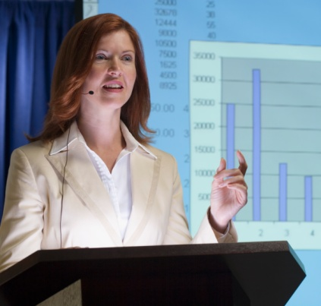
Behaviors/Attributes to Exhibit
Speaks clearly
Demonstrates poise and confidence
Has command of the subject matter
Involves audience
Is receptive to questions
Copyright © 2000 - 2009 by Michael J. Miller. All rights reserved.

Slide 17
Three Lines of
Empirical Research
Descriptive research
  “How things are”
Relational (or correlational) research
  “How things are in relation to other things”
Experimental research
  “How things are and how they got to be that way”
Copyright © 2000 - 2009 by Michael J. Miller. All rights reserved.

Slide 18
Descriptive Research
Describe what is happening behaviorally
  Example: Health outcomes for senior citizens
Necessary first step
Foundation for future inquiries
Does not explain how or why
Copyright © 2000 - 2009 by Michael J. Miller. All rights reserved.

Slide 19
Relational (Correlational) Research
Measure and estimate relationship between two or more variables
  Example: Exercise and elevated moods
Examine:
  If variables are significantly related
  Direction of relationship
  Strength of relationship
Does not demonstrate causality!
Copyright © 2000 - 2009 by Michael J. Miller. All rights reserved.

Slide 20
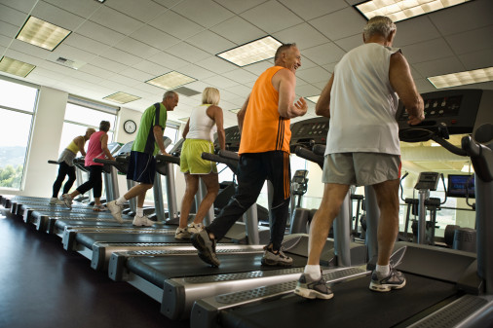
Experimental Research
Manipulate conditions responsible for effect
  Example: Expose group of senior citizens to exercise program
  Treatment / experimental group vs. control group
Implies causation
Copyright © 2000 - 2009 by Michael J. Miller. All rights reserved.

